Slide 1
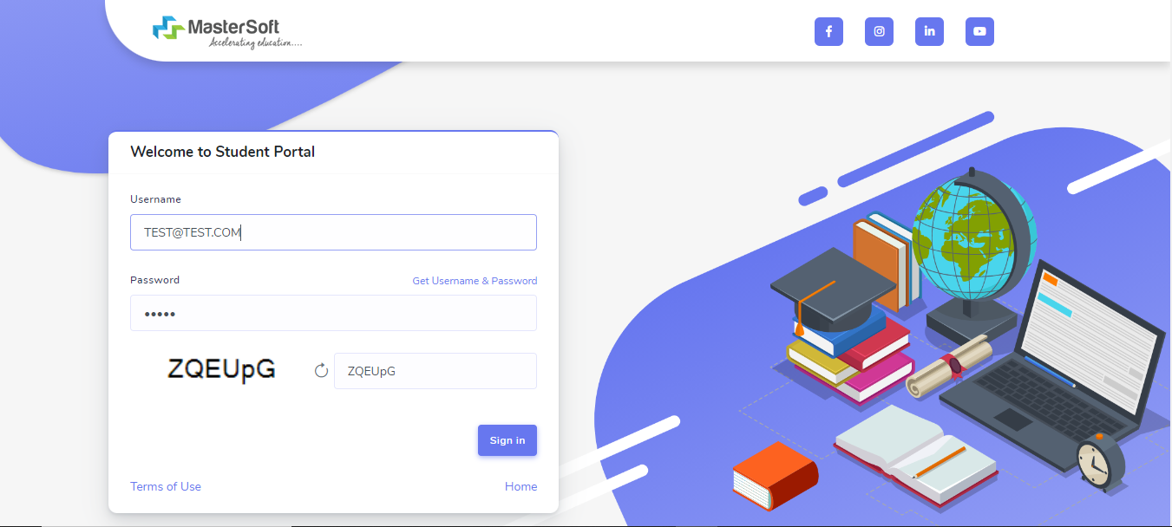
Step1: Click on https://cimsstudentnewui.mastersofterp.in/ to visit Student Portal and then click on "Get Username and Password" button given on the screen.

Slide 2
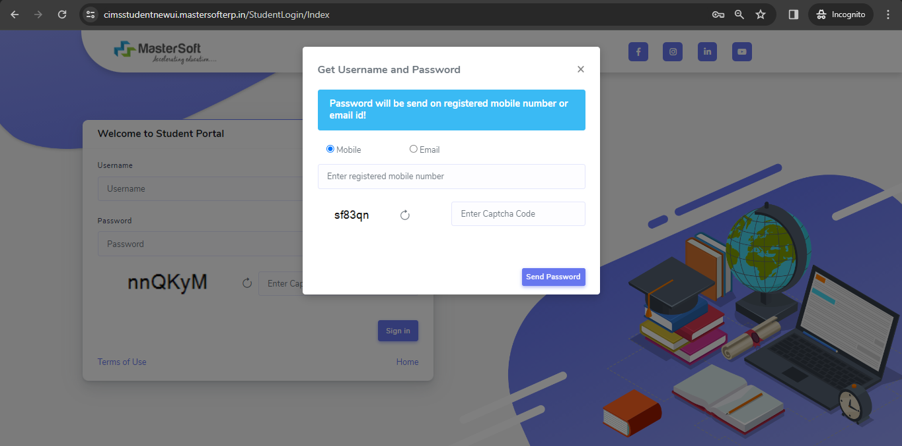
Step2: You need to enter your registered Mobile Number or Registered Email-id.

Slide 3
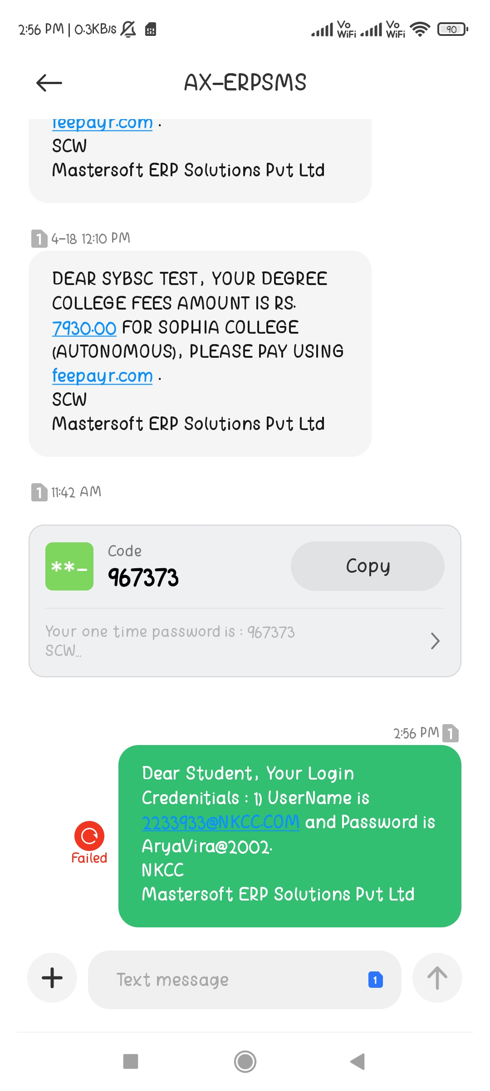
Step3: On entering the mobile number, username and password will be generated and send on your registered Mobile Number or Email-id Respectively.

Slide 4
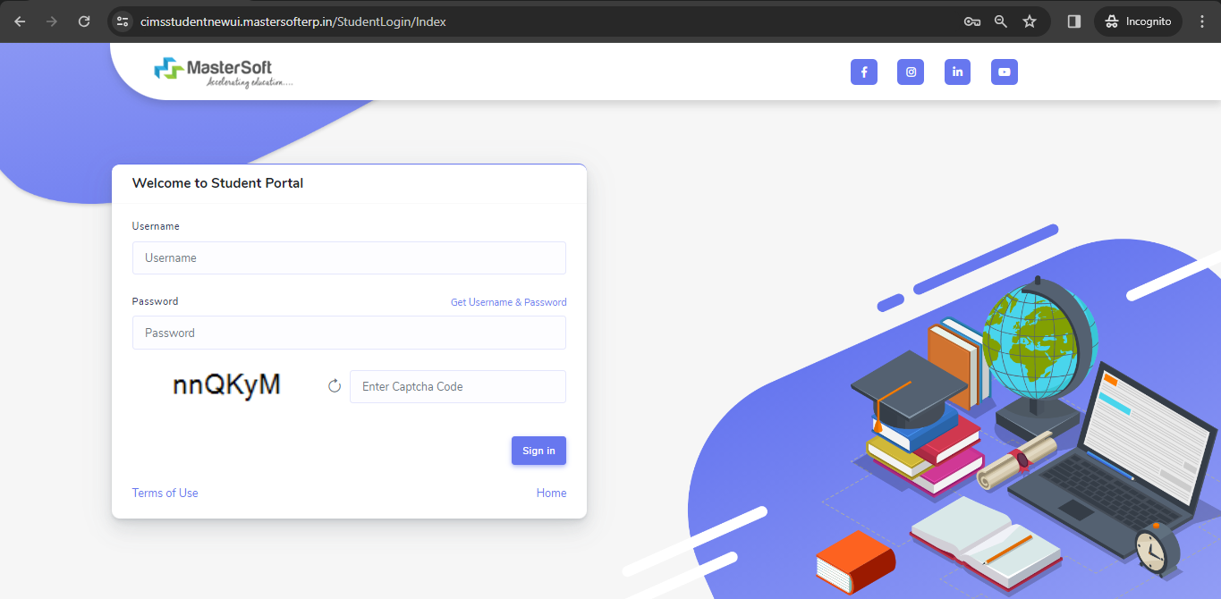
Step4: Enter the credentials which you have received and click on the Sign in option to Successfully Login To The System.

Slide 5
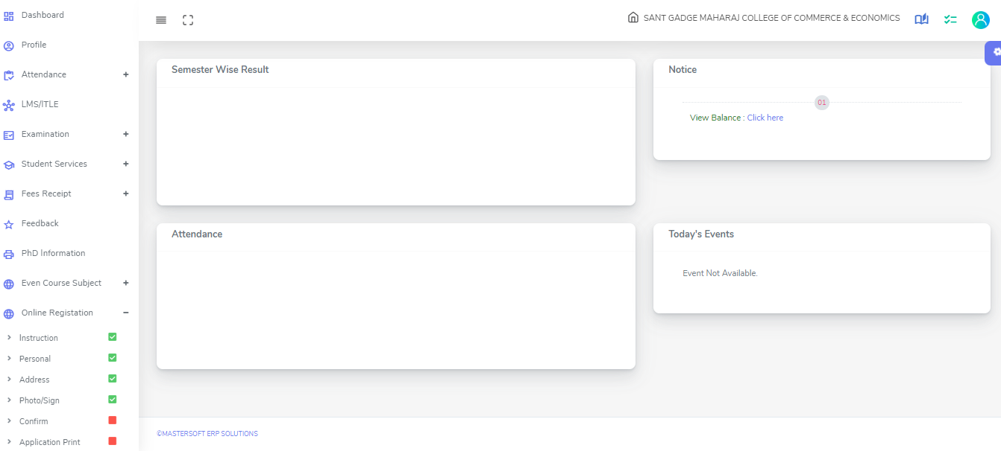
Step 5: For commencing Online Registration Process, click on the Online Registration Option present on the left-hand side of the screen.

Slide 6
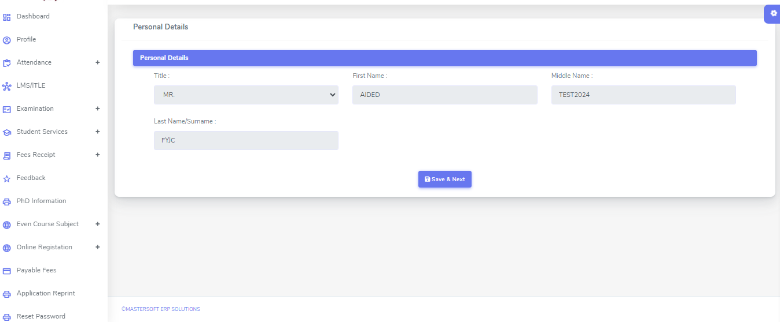
Step 6: Now click on the Personal Tab present on the left-hand side of the screen. The first field that is personal, you need to enter your personal details here like your first name, middle name, last name, email, gender etc. Once you complete filling the personal details click on “Save and Next Button". (Please note that all the red mark fields are mandatory)

Slide 7
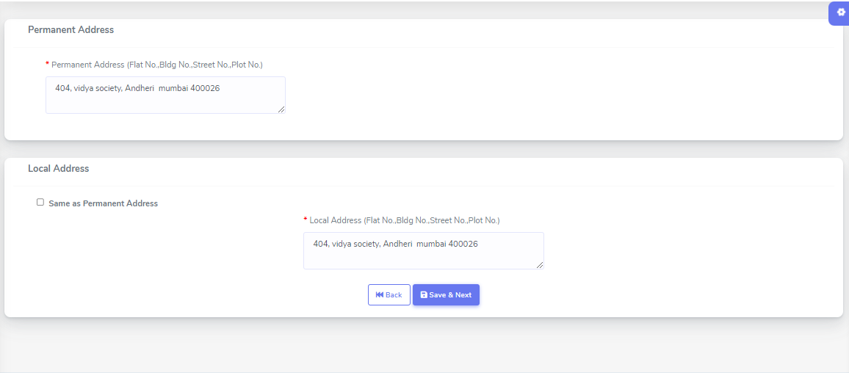
Step 7: Next page is address details, here you need to fill your Personal or Local address. Once you complete filling the address details form click on “Save and Next Button".

Slide 8
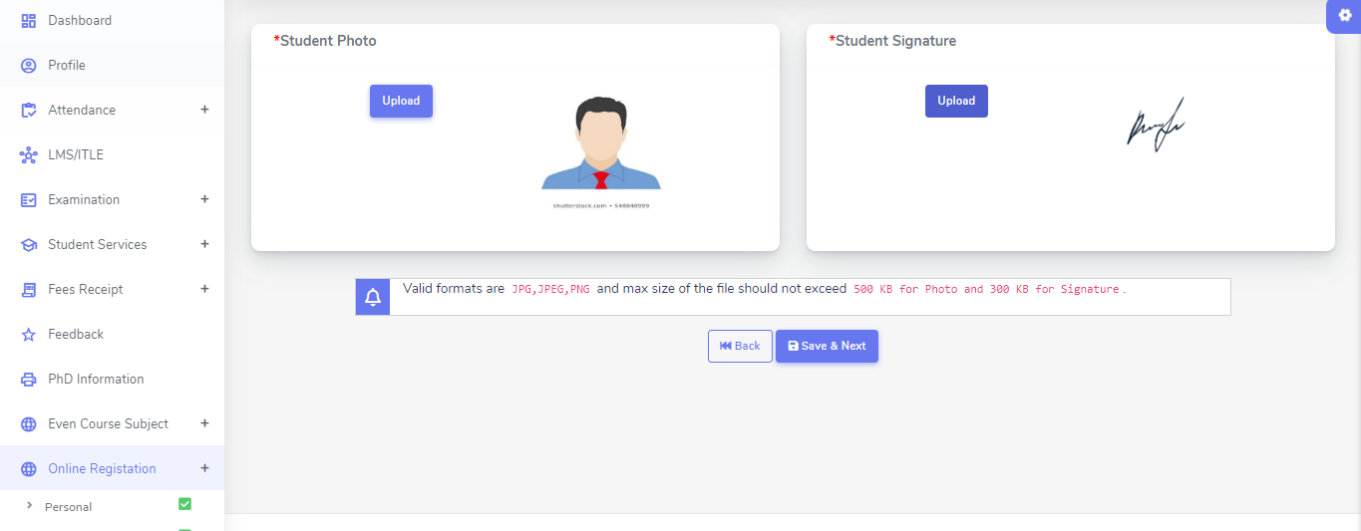
Step8: Next page is photo and signature page, here you need to Upload Your Photo and Signature. Click on the Upload Photo and Upload Signature and select the valid file. Once you complete uploading photo and signature then click on “Save and Next Button". (Note: photo size should be max 500kb and Signature size should be max 300kb)

Slide 9
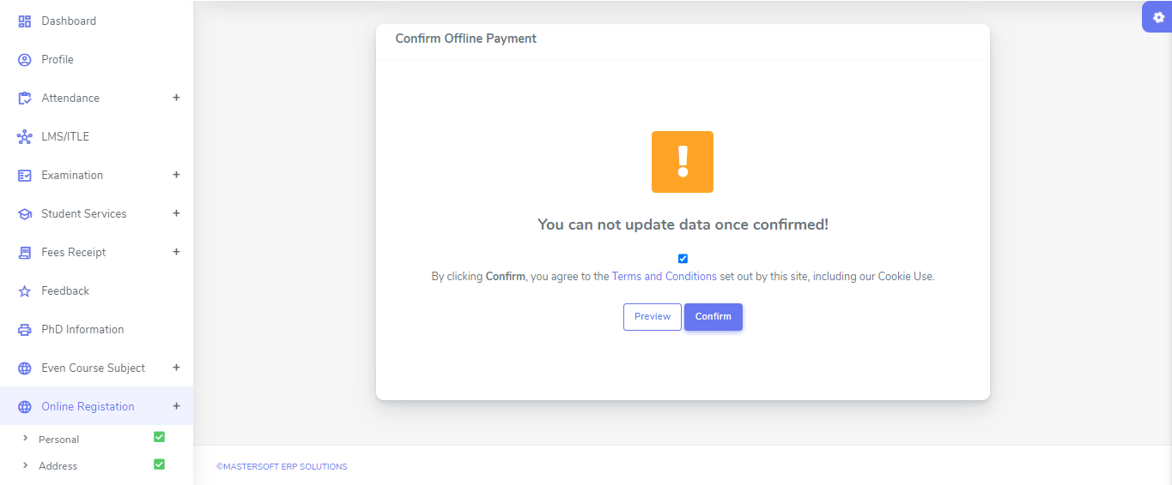
Step12: Next page is confirm, you need to Confirm All The Details you have filled because you won't be able to Update/Edit the data after Confirmation. Once you are sure that the details entered by you are true and correct click “Confirm" Button.

Slide 10
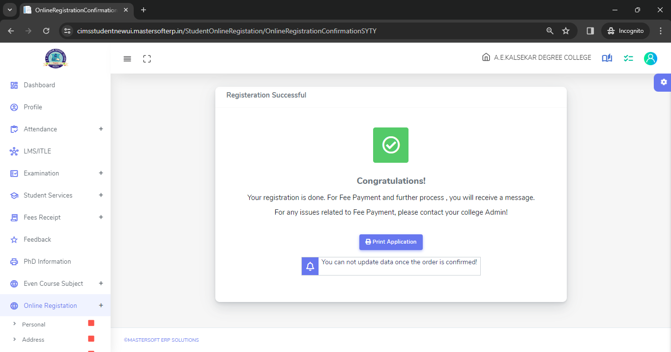
Step 13: Now to print your application click on "Print Application" Option present in the left-hand side of the screen. Application form will include all your details such as personal details, academic details, photo-signature etc.

Slide 11
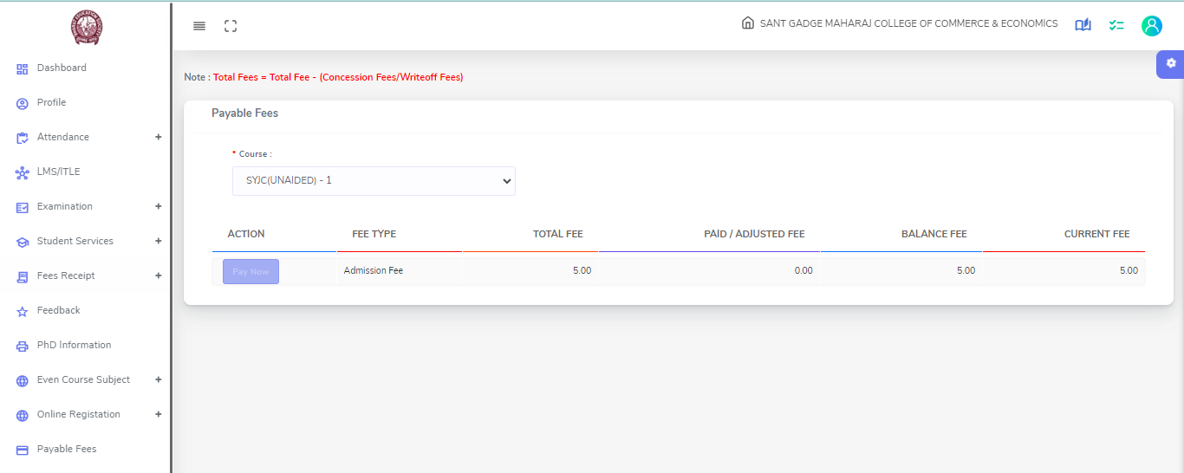
Step 14: Now to pay your fees click on "Payable Fees” present in the left-hand side of the screen. After clicking on this option you will get your fees amount , click on “Pay Now” option for payment

Slide 12
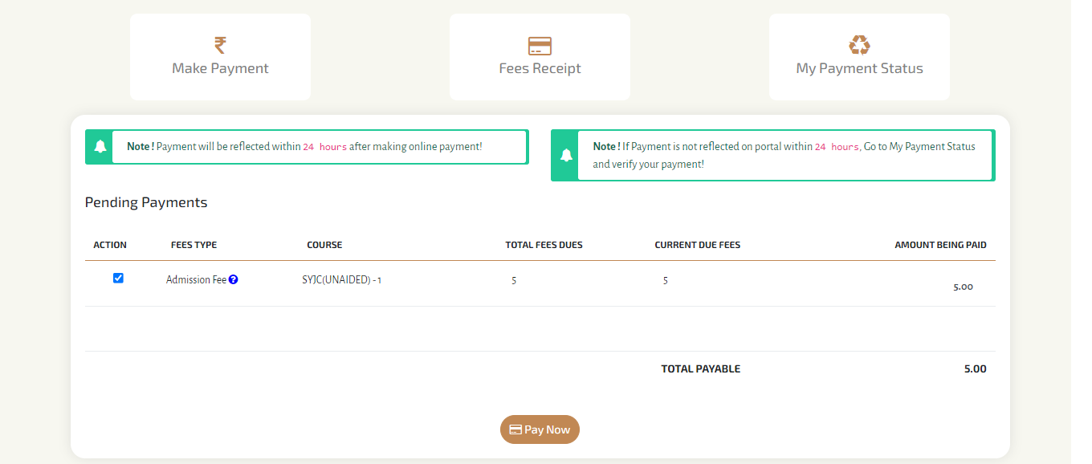
Step 15: Select the amount &Click on Pay Now option , it will redirect you to payment gateway

Slide 13
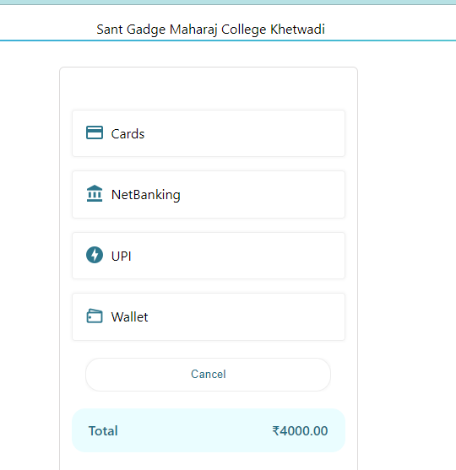
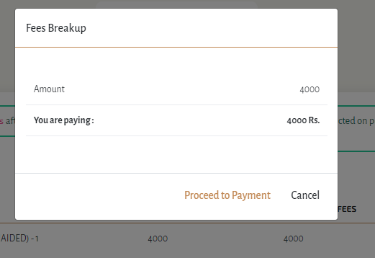
Step 16: You can pay amount through various options

